Slide 1
Trees
Data Structures and Algorithms
Nanjing University, Fall 2024
郑朝栋

Slide 2
Trees
A tree is a connected, acyclic undirected graph.
In CS, we often study rooted trees.
root

Slide 3

Recursive definition of Trees
A tree is either empty, or has a root $r$ that connects to the roots of zero or more non-empty (sub)trees.
Root of each subtree is a child of $r$, and $r$ is the parent of each subtree’s root.
Nodes with no children are leaves.
Nodes with same parent are siblings.
If a node $v$ is on the path from $r$ to $u$, then $v$ is an ancestor of $u$, and $u$ is a descendant of $v$.
parent
child
ancestor
descendant
sibling
leaves

Slide 4






More terminology on Trees
The depth of a node $u$is the length of the path from $u$ to $r$.
The height of a node $u$ is the length of the longest path from $u$ to one of its descendants.
Height of a leaf node is zero.
Height of a non-leaf node is the max height of its children plus one.
$$r$$
$$d=1$$
$$h=2$$
$$d=3$$
$$h=0$$

Slide 5

Binary Trees
A binary tree is a tree in which each node has at most two children.
Often call these children as left child and right child.
$$r$$

Slide 6
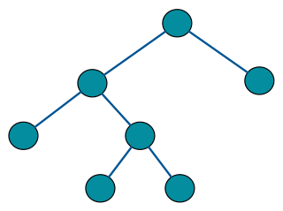
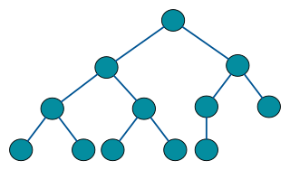
More terminology on Binary Trees
A full binary tree is a binary tree where each node has either zero or two children.
A full binary tree is either a single node, or a tree in which the two subtrees of the root are full binary trees.
A complete binary tree is a binary tree where every level, except possibly the last, is completely filled, and all nodes in the last level are as far left as possible.
A complete binary tree can be efficiently represented using an array.
A perfect binary tree is a binary tree where all non-leaf nodes have two children and all leaves have same depth.
CLRS call perfect binary trees as complete binary trees.

Slide 7
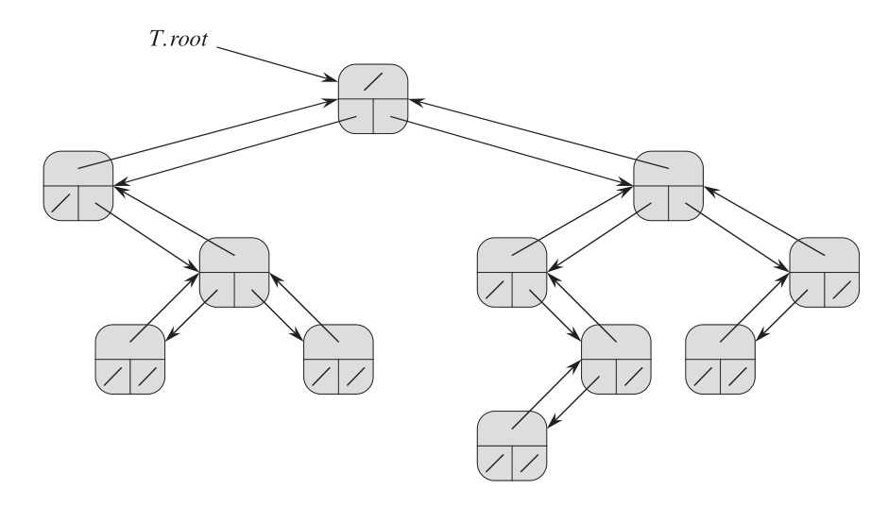
Representing Binary Trees
struct Node {
Data data;
Node *parent;
Node *left;
Node *right;
}
What if nodes have more children?

Slide 8
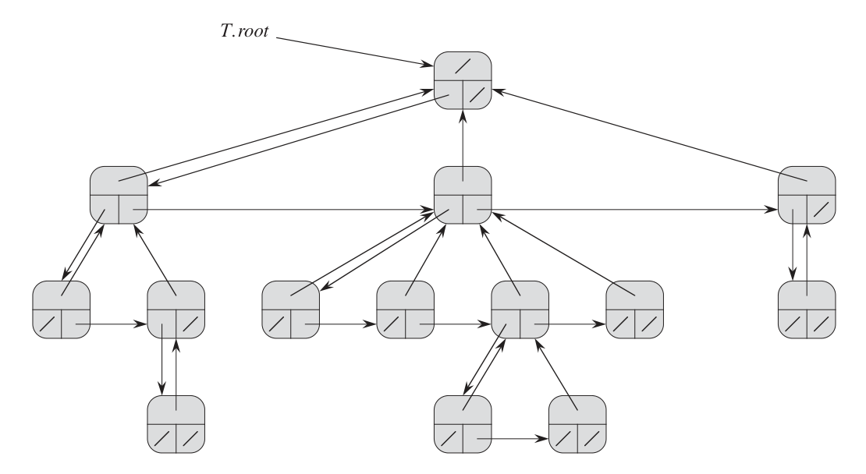
Representing General Trees
“Left-child, right-sibling representation.”
struct Node {
Data data;
Node *parent;
Node *firstChild;
Node *nextSibling;
}

Slide 9
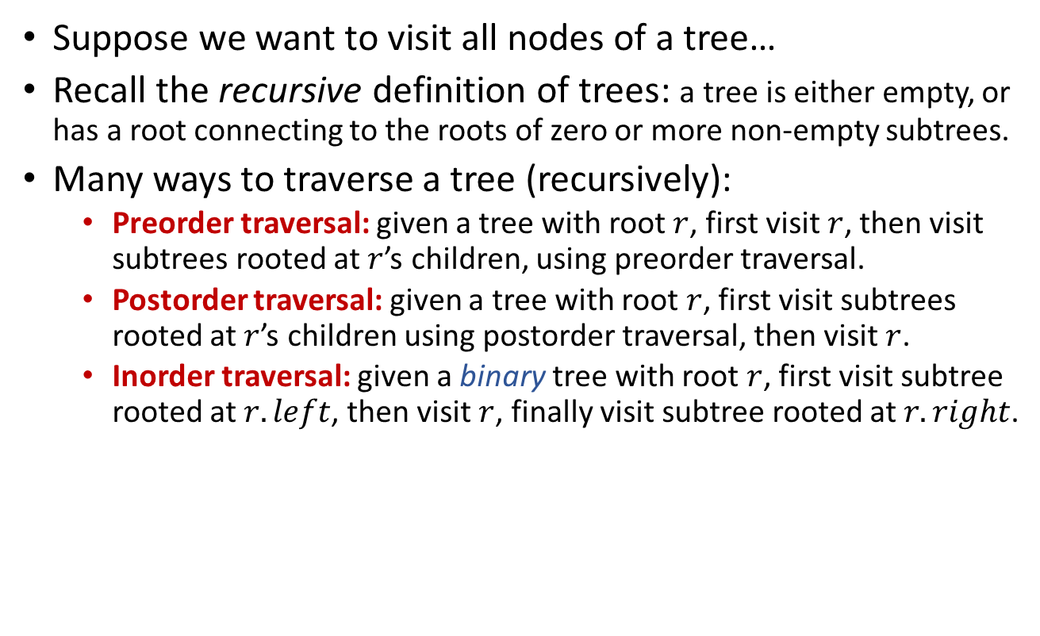
Tree Traversals
PreorderTrav(r):
if (r != NULL)
Visit(r)
for (each child u of r)
PreorderTrav(u)
PostorderTrav(r):
if (r != NULL)
for (each child u of r)
PostorderTrav(u)
Visit(r)
Suppose we want to visit all nodes of a tree…
Recall the recursive definition of trees: a tree is either empty, or has a root connecting to the roots of zero or more non-empty subtrees.
Many ways to traverse a tree (recursively):
Preorder traversal: given a tree with root $r$, first visit $r$, then visit subtrees rooted at $r$’s children, using preorder traversal.
Postorder traversal: given a tree with root $r$, first visit subtrees rooted at $r$’s children using postorder traversal, then visit $r$.
Inorder traversal: given a binary tree with root $r$, first visit subtree rooted at $r.left$, then visit $r$, finally visit subtree rooted at $r.right$.
InorderTrav(r):
if (r != NULL)
InorderTrav(r.left)
Visit(r)
InorderTrav(r.right)

Slide 10










Preorder Traversal
PreorderTrav(r):
if (r != NULL)
Visit(r)
for (each child u of r)
PreorderTrav(u)
$$41$$
$$20$$
$$65$$
$$11$$
$$29$$
$$50$$
$$91$$
$$32$$
$$72$$
$$99$$
41
20
11
29
32
65
50
91
72
99

Slide 11
Postorder Traversal
PostorderTrav(r):
if (r != NULL)
for (each child u of r)
PostorderTrav(u)
Visit(r)
$$41$$
$$20$$
$$65$$
$$11$$
$$29$$
$$50$$
$$91$$
$$32$$
$$72$$
$$99$$
11
32
29
20
50
72
99
91
65
41

Slide 12
Inorder Traversal
InorderTrav(r):
if (r != NULL)
InorderTrav(r.left)
Visit(r)
InorderTrav(r.right)
$$41$$
$$20$$
$$65$$
$$11$$
$$29$$
$$50$$
$$91$$
$$32$$
$$72$$
$$99$$
11
20
29
32
41
50
65
72
91
99

Slide 13




Complexity of recursive traversal
PreorderTrav(r):
if (r != NULL)
Visit(r)
for (each child u of r)
PreorderTrav(u)
Time complexity for a size $n$ tree?
$Θ(n)$ as processing each node takes $Θ(1)$.
Space complexity for a size $n$ tree?
PostorderTrav(r):
if (r != NULL)
for (each child u of r)
PostorderTrav(u)
Visit(r)
$O(n)$ as worst-case call stack depth is $Θ(n)$.
InorderTrav(r):
if (r != NULL)
InorderTrav(r.left)
Visit(r)
InorderTrav(r.right)

Slide 14
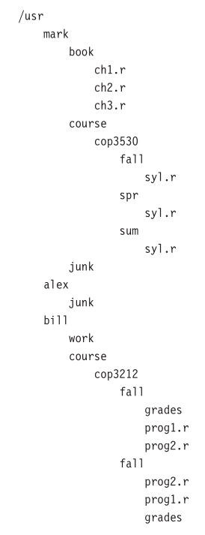
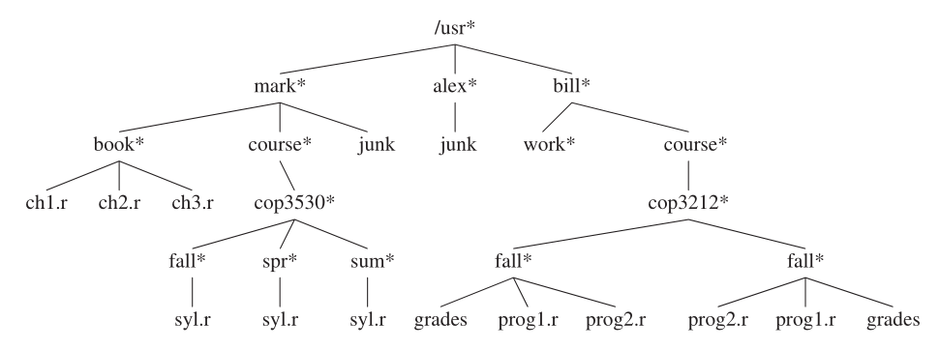
Sample application of preorder traversal Directory Listing
PreorderTrav(r):
if (r != NULL)
Visit(r)
for (each child u of r)
PreorderTrav(u)
ListDir(obj, depth):
if (obj != NULL)
PrintName(obj,depth)
if (IsDirectory(obj))
for (each obj in directory)
ListDir(obj,depth+1)

Slide 15
Iterative tree traversal
Basic idea: simulate the recursive process with the help of a stack.
PreorderTrav(r):
if (r != NULL)
Visit(r)
for (each child u of r)
PreorderTrav(u)
PreorderTravIter(root):
Stack s
s.push(Frame(root,false))
while (!s.empty())
f = s.pop()
if (f.node != NULL)
if (f.visit)
Visit(f.node)
else
for (each child u of f.node)
s.push(Frame(u,false))
s.push(Frame(f.node,true))
struct Frame {
Node *node;
bool visit;
Frame(Node* n,bool v) {
node = n;
visit = v;
}
}
What about postorder traversal?
Visit node or the subtree rooted at node.
What about inorder traversal?

Slide 16




Iterative inorder tree traversal
InorderTravIter(root):
Stack s
s.push(Frame(root,false))
while (!s.empty())
f = s.pop()
if (f.node != NULL)
if (f.visit)
Visit(f.node)
else
s.push(Frame(f.node->right,false))
s.push(Frame(f.node,true))
s.push(Frame(f.node->left,false))
struct Frame {
Node *node;
bool visit;
Frame(Node* n,bool v) {
node = n;
visit = v;
}
}
$$r$$
What is the time complexity?
$$Θ(n)$$
What is the space complexity?
$$O(n)$$
When do we need $Θ(n)$ space?
Can we have better space complexity?
Yes! Knowing last visited node tells us what to do next.

Slide 17
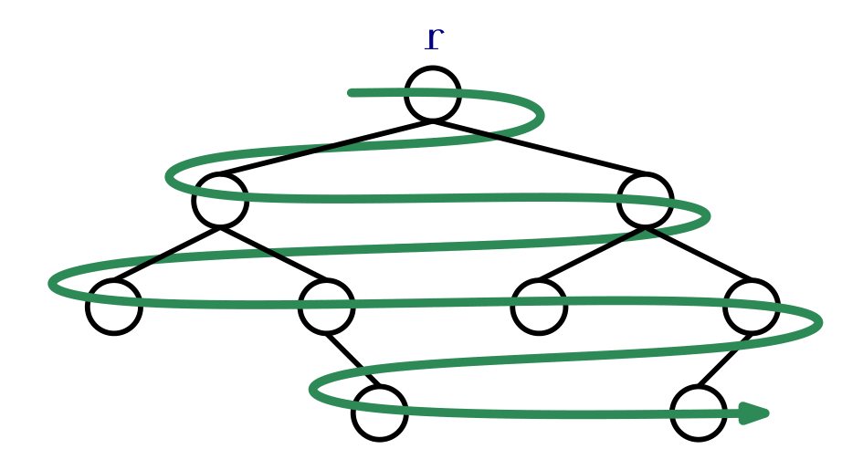


Level-order traversal of trees
Recursive MergeSort is somewhat like a postorder traversal of the recursion tree.
Iterative MergeSort is somewhat like a level-order traversal of the recursion tree, but bottom-up…
LevelorderTrav(r):
Queue q
q.add(r)
while (!q.empty())
node = q.remove()
if (node != NULL)
Visit(node)
q.add(node->left)
q.add(node->right)
What is the time complexity?
$$Θ(n)$$
What is the space complexity?
$Θ(n)$ in the worst-case.

Slide 18

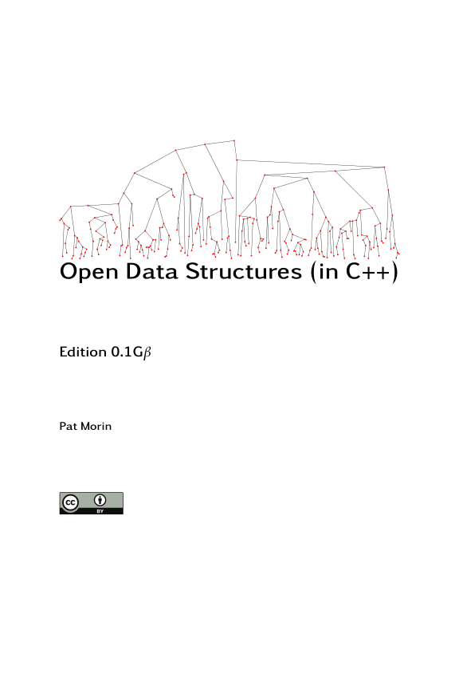
Reading
[CLRS] Ch.10 (10.4)
[Weiss] Ch.4 (4.1-4.2)
[Morin] Ch.6 (6.1)

